Slide 1
EURope

Slide 2
746,4 million inhabitants
47 countries
150 – 200 different languages

Slide 3
seas
Baltic Sea = Ostsee
European North Sea = Europäisches Nordmeer
North Sea = Nordsee
Black Sea = Schwarzes Meer
Atlantic Ocean = Atlantischer Ozean
Caspian Sea = Kaspisches Meer
Mediterranean Sea = Mittelmeer

Slide 4
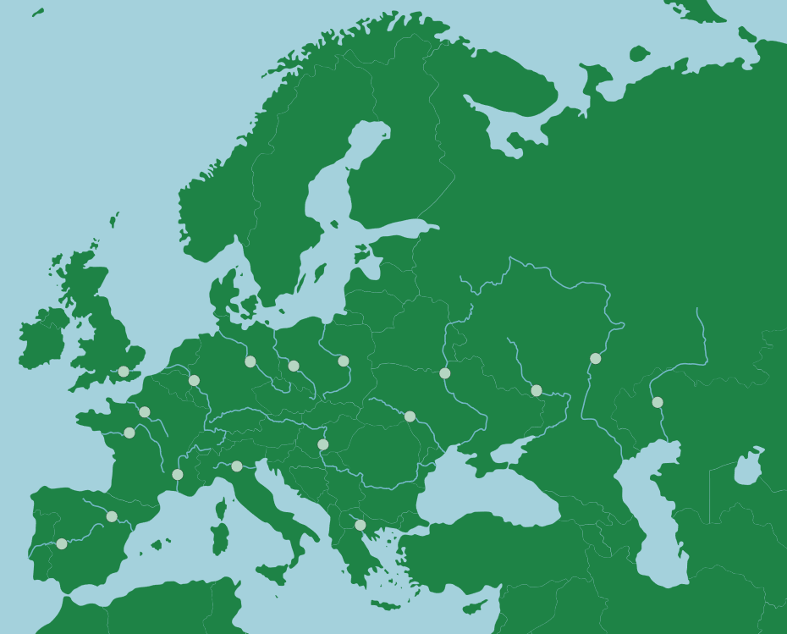
rivers
Dnjepr : 2285km
Wolga : 3530km
Danube = Donau : 2845km

Slide 5
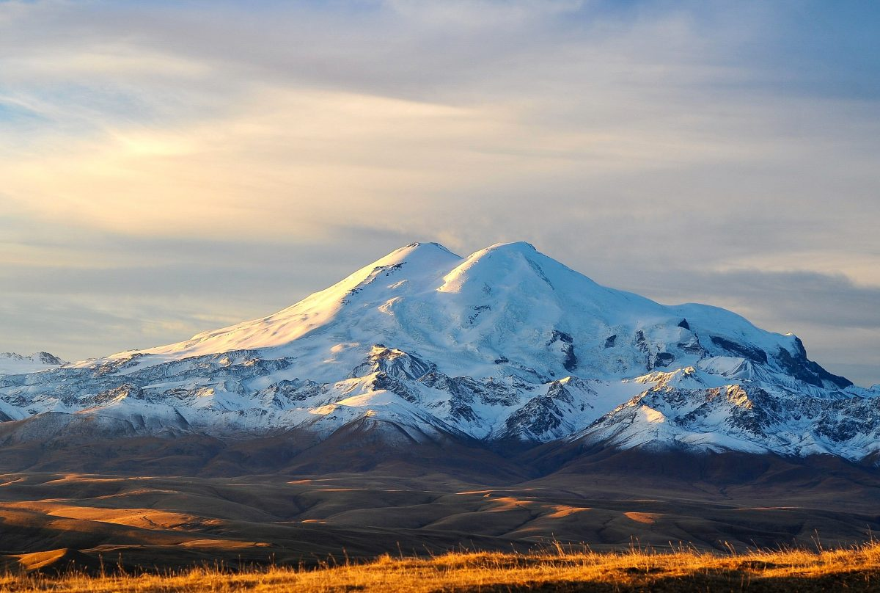
Mountain
Elbrus : 5642m

Slide 6
Austria´s neighbours

Slide 7
QUELLEN:
WorksheetCrafter
https://online.seterra.com/de/vgp/3132
https://lifeinrussia.net/mount-elbrus-the-highest-mountain-in-europe/
https://www.sutori.com/story/osterreich--W5dxGQP5Ug1jKWUxg3GRNhE2

